Slide 1
Measuring solubility

Slide 2
The temperature affects the amount of a substance that dissolves in a solvent.
The solubility of a solute is the maximum amount in grams that can dissolve in 100g of the solvent at a given temperature.
The solution in which no more solute can be dissolved in a solvent at a particular temperature is known as a saturated solution. Before this point it is known as an unsaturated solution.

Slide 3
If the solvent water is heated, then more solute can be dissolved. If the heated solution is allowed to cool, crystals will start to precipitate again. The temperature at which this happens is the temperature at which the solution is saturated.
Supersaturated solution
A solution can become supersaturated when there is more solute dissolved than in a saturated solution at the same temperature.

Slide 4
Toffee is a supersaturated solution of sugar. To stop the toffee crystallising, a mixture of sugars or the addition of some fats can be used to stabilise the solution.

Slide 5
Solubility curves
A graph showing how much of a solute such as a salt can be dissolved at a particular temperature provides useful information on the solubility of a substance. As temperature increases more salt will dissolve. This graph is called as solubility curve.
The amount of solute is measured in grams of solute in 100 grams of water.

Slide 6
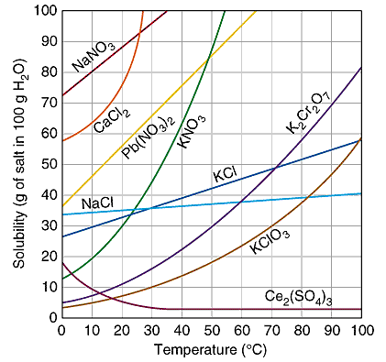
A selection of solubility curves for various salts

Slide 7
Gas solubility curves
Solubility of gases can be shown with the help of solubility curves. As temperature increases, solubility of non-polar gases generally decreases. Solubilities are much lower than that for solids and values are shown in parts per million(ppm).

Slide 8
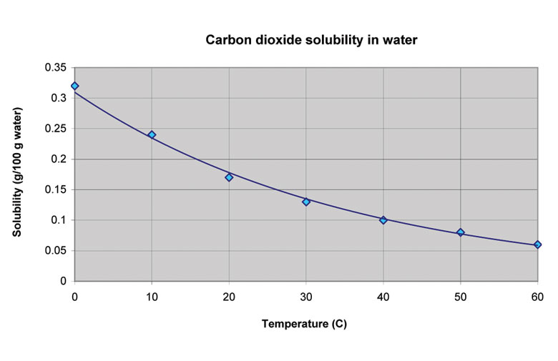

Slide 9
Concentration units
Solubility curves use the unit grams of solute per 100g of water.
Concentration is a measure of the amount of solute present.
There are a variety of units in general use; g/100g,
%v/v ( percent by volume),
% w/w (percent by weight),
%v/w, ppm (parts per million, grams of solute in one million grams of solution)

